Slide 1
Individual Project Presentation
Rana Mittra

Slide 2
Contents
Project Summary
Project Demo
How Training Contributed to the Project
Difficulties
Improvements
Conclusion

Slide 3
Project Summary – Word Generator
The

Slide 4
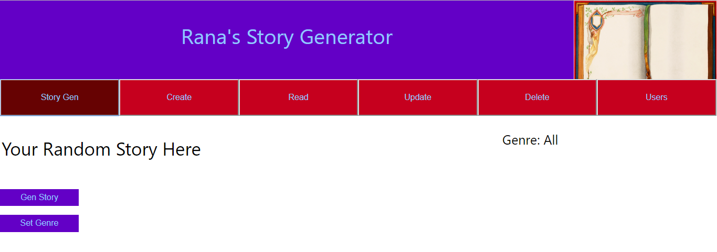
Project Demo
Story Generator

Slide 5
A RESTful API
Weeks 4/6
Week 5
Weeks 2-5
Week 4-5
Front End
REST Layer
Business
Persistence
Implements
Rules
Java SE and EE
Database
React
CSS
Assigns function to paths
JPA & Hibernate

Slide 6
Week 1: Organisation
Trello
Went well – gave project work focus.
Splitting sections into smaller tasks made project feel achievable.
Easier to keep motivation.

Slide 7
Weeks 2&3 - Java
Didn’t know Java, couldn’t make the project or make it OOP. Used in Business layer.
Necessary background for Java EE.
Front End
REST Layer
Business
Persistence
DB

Slide 8
Weeks 4&5 – Upgrading to EE
Adding APIs to improve functions.
Expands functionality to REST and persistence layers.
SQL, connecting API to a database.
Structuring SQL queries allowed for random story feature.
Went well: Making conditional queries.
Well organised – adherence to SOLID

Slide 9
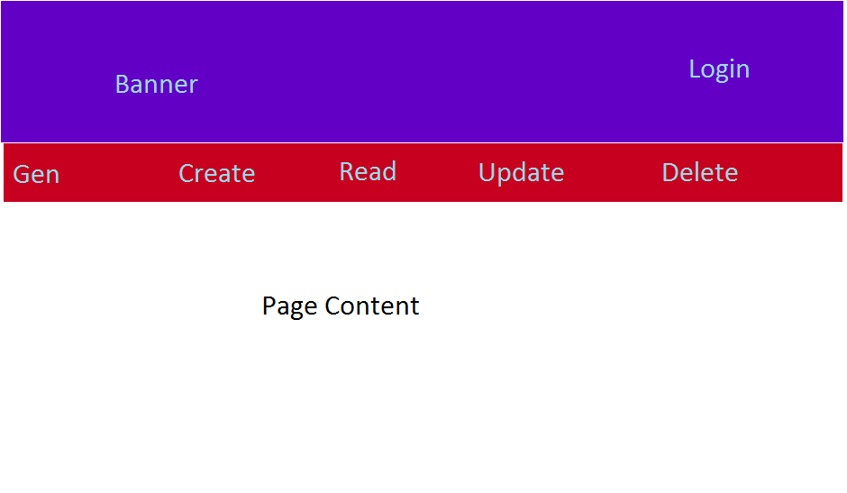
Week 6 – Front End with JS and React
Convert wireframe to HTML site
Convert that HTML to React for faster use.
Adding libraries - Axios and Routers

Slide 10
Week 7 - Testing
Static Testing using Sonarqube
Made a Test Suite.
Code Review by a Peer
Basic Selenium Tests

Slide 11
Challenges
CORS – Fixed allowing 8080 server to allow 3000 server to interact.
Converting to React – Changing JS functions to React syntax
Populating Database

Slide 12
Hopes for Improvement
Restructuring website for conditional routing
User exclusive functions
Need to be logged in to use CRU functions.
Admin user who is only one can use delete functions.

Slide 13
Summary

Slide 14
Any questions?

